Slide 1
Porter
Delivery Analysis

Slide 2
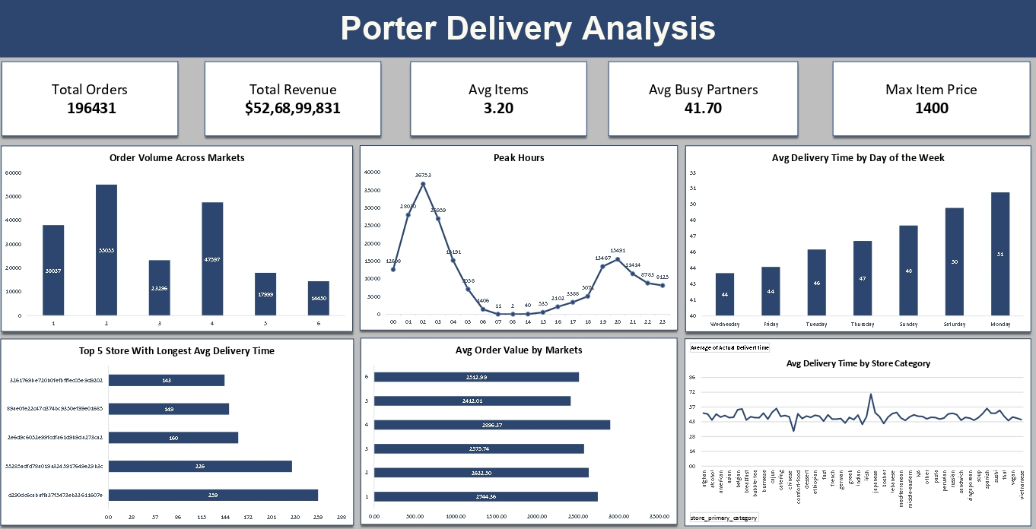
Contents of this template
Here’s what you’ll find in this Slidesgo template:
A slide structure based on a multi-purpose presentation, which you can easily adapt to your needs. For more info on how to edit the template, please visit Slidesgo School or read our FAQs.
To view this template with the correct fonts in ppt format, download and install on your computer the fonts that we have used. You can learn how to download and install fonts here.
An assortment of graphic resources that are suitable for use in the presentation can be found in the alternative resources slide.
A thanks slide, which you must keep so that proper credits for our design are given.
A resources slide, where you’ll find links to all the elements used in the template.
Instructions for use.
Final slides with:
The fonts and colors used in the template.
A selection of illustrations. You can also customize and animate them as you wish with the online editor. Visit Storyset to find more.
More infographic resources, whose size and color can be edited.
Sets of customizable icons: general, business, avatar, creative process, education, help & support, medical, nature, performing arts, SEO & marketing, and teamwork.
You can delete this slide when you’re done editing the presentation

Slide 3
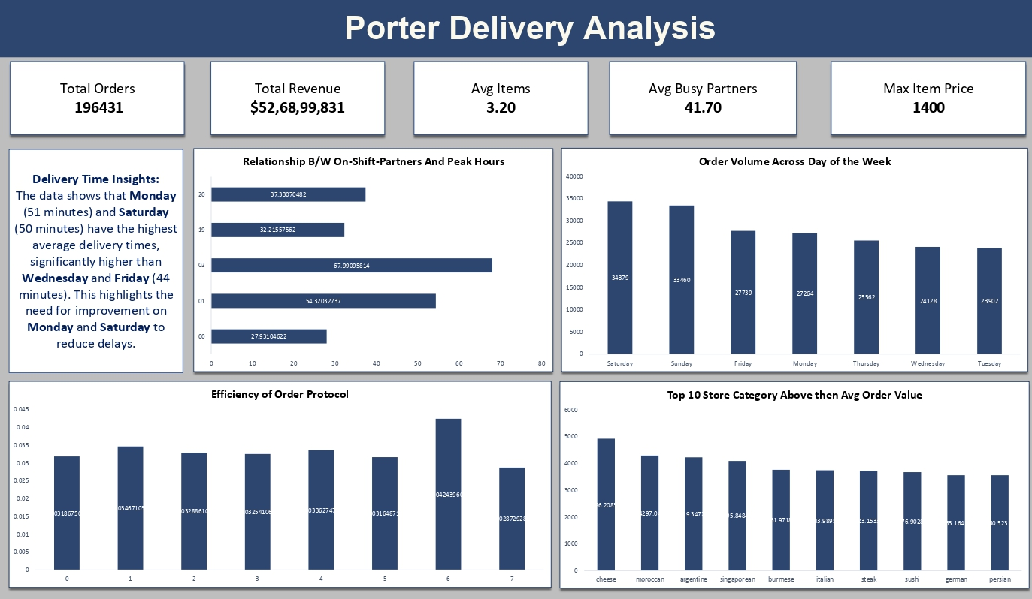
Contents of this template
Here’s what you’ll find in this Slidesgo template:
A slide structure based on a multi-purpose presentation, which you can easily adapt to your needs. For more info on how to edit the template, please visit Slidesgo School or read our FAQs.
To view this template with the correct fonts in ppt format, download and install on your computer the fonts that we have used. You can learn how to download and install fonts here.
An assortment of graphic resources that are suitable for use in the presentation can be found in the alternative resources slide.
A thanks slide, which you must keep so that proper credits for our design are given.
A resources slide, where you’ll find links to all the elements used in the template.
Instructions for use.
Final slides with:
The fonts and colors used in the template.
A selection of illustrations. You can also customize and animate them as you wish with the online editor. Visit Storyset to find more.
More infographic resources, whose size and color can be edited.
Sets of customizable icons: general, business, avatar, creative process, education, help & support, medical, nature, performing arts, SEO & marketing, and teamwork.
You can delete this slide when you’re done editing the presentation

Slide 4
Table of contents
01
02
03
Problem & Background
Stakeholders
Goals & KPI
04
05
Recommended Analysis
Conclusions

Slide 5
01
Problem & Background
Porter Delivery, a rapidly growing company in the food delivery industry, faced declining customer satisfaction due to delivery delays in key markets. Despite its expansion, these delays risked eroding market share. The challenge was to analyze the factors affecting delivery times, uncover the root causes of delays, and identify areas for improvement. The goal was to optimize operational efficiency and enhance customer satisfaction to help the company maintain its competitive edge.

Slide 6
Stakeholders
Internal: Operations team, Marketing department, Customer service, Logistics team
External: Partner restaurants, Delivery personnel

Slide 7
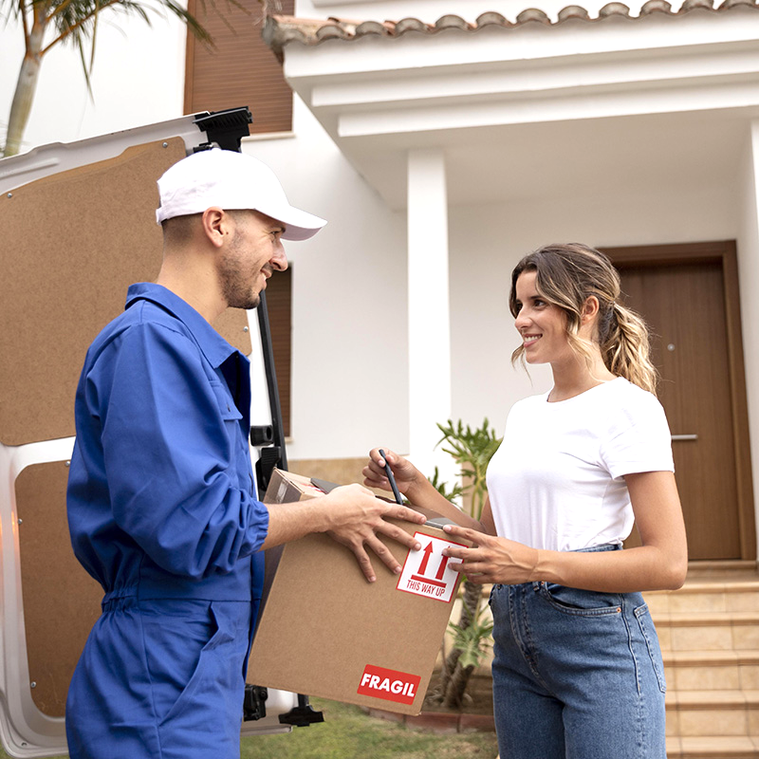
Goals & KPI
Reduce Delivery Times: Identify factors causing delays and minimize overall delivery times without compromising service quality.
Improve Customer Satisfaction: Enhance delivery efficiency to boost satisfaction and loyalty in key markets.
Optimize Operations: Analyze data to streamline delivery routes, manage peak times, and eliminate bottlenecks.
Data-Driven Decision Making: Provide actionable insights to internal teams and external partners to drive performance improvements.

Slide 8

Key Performance Indicator(KPI)
196431
41.70
$52,68,99,831
1400
3.20
196431
Total Orders
Average Busy Partners
Total Revenue
Maximum Item Price
Average items Per Order
Total Orders

Slide 9
Key Insights
Delivery Time Insights: The data shows that Monday (51 minutes) and Saturday (50 minutes) have the highest average delivery times, significantly higher than Wednesday and Friday (44 minutes). This highlights the need for improvement on Monday and Saturday to reduce delays.

Slide 10
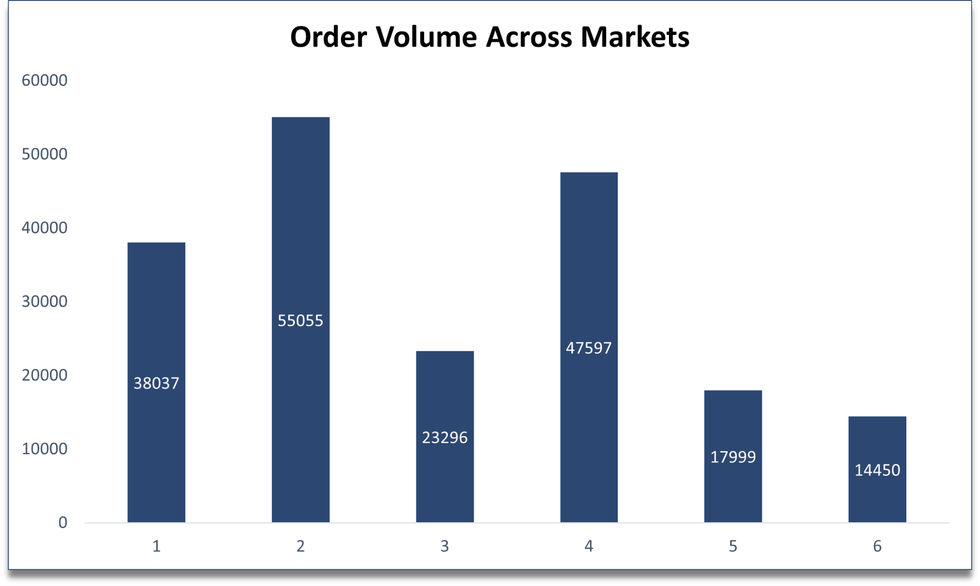
Recommended Analysis
Q1 What is the distribution of order volumes across different markets?

Slide 11
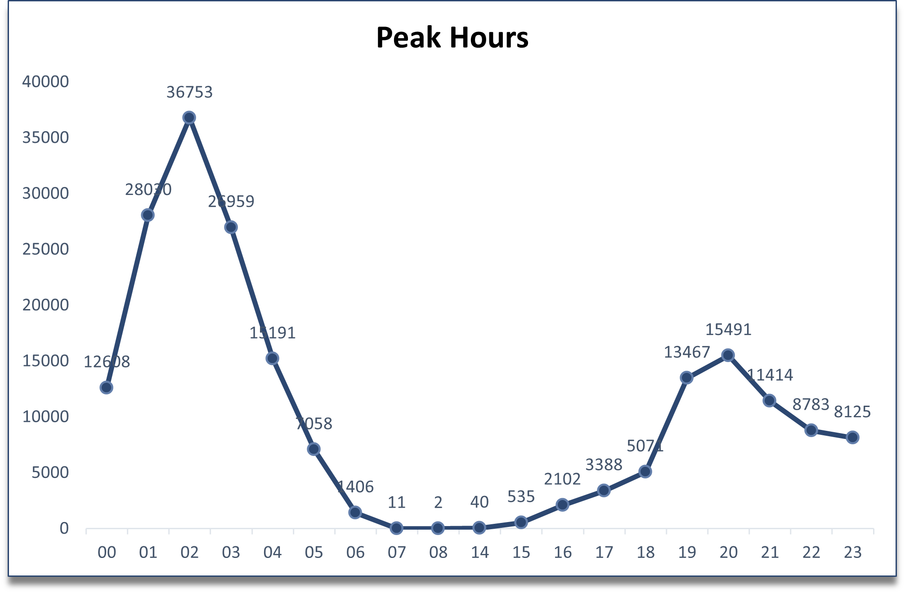
Recommended Analysis
Q2 What are the peak hours for order placements?
The identified peak hours are from 12 PM to 2 PM during lunch and 7 PM to 9 PM in the evening, where delivery demand is highest.

Slide 12
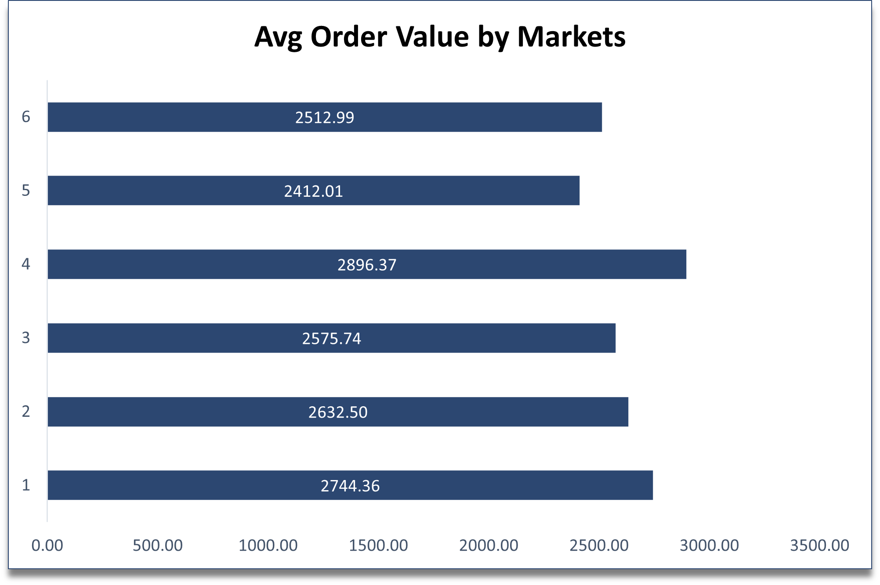
Recommended Analysis
Q3 How does the average order value vary by market?

Slide 13
Conclusion
Peak Delivery Delays: Monday and Saturday have the highest average delivery times, requiring focused improvements.
Key Bottlenecks: Peak hours (12 PM - 2 PM, 7 PM - 9 PM) show the greatest strain on delivery efficiency.
Busy Partners: An average of 41 delivery partners are occupied during peak times, contributing to longer delivery times.
Operational Optimization: Enhancing delivery routes and increasing available staff during peak hours can significantly reduce delays.
Customer Satisfaction: Reducing delivery times on high-demand days and during peak hours will improve overall customer satisfaction.
Data-Driven Insights: Continued monitoring and data analysis will help sustain performance improvements.

Slide 14
Thanks!
Do you have any questions?
Portfolio - https://peerlist.io/kunalmalviya06 Linkedin - https://www.linkedin.com/in/kunalmalviya06/ Discord - kunalmalviya06

